Slide 1
SPEECH EMOTION RECOGNITION USING SUPPORT VECTOR MACHINE LEARNING ALGORITHM

Slide 2

BATCH NO.: 8 GUIDED BY:
MRS.G.DHANALAKSHMI M.E.,
ASST.PROFESSOR–
INFORMATION TECHNOLOGY,
PANIMALAR INSTITUTE OF TECHNOLOGY.
TEAM MEMBERS:
LAKSHMI PRIYA.B.M - 211519205086
RACHEAL SWARNA KUMAR.S - 211519205119
YAMINI.M - 211519205180

Slide 3
ABSTRACT:
Recognizing emotion is a key feature needed to build socially aware systems. Therefore, it is an important part of human-computer interaction (HCI). Speech interaction between human interlocutors and between humans and machines is inescapably embedded within the laws and conditions of communication, which comprise the encoding and decoding of meaning as well. Here we deal with the human and machine interaction through synthesis and recognition applications. Speech emotion recognition (SER) has enormous potential given the ubiquity of speech-based devices.
It involves capturing and digitizing the sound waves and contextually analyzing the emotions using tone, pitch, rhythm, etc., SER is usually beneficial for applications, which require human-computer interaction like speech synthesis, Speech recognition allows you to provide input to an application with your voice and the speech features, Mel Frequency Cepstrum Coefficients (MFCC) is extracted from speech utterance. The applications and limitations enlighten the impact of speech processing in our modern technical field. This project drives increasing attention towards the recognition of emotions spontaneously from speech with thought-provoking tasks by Emotion Recognition from Speech using Machine Learning- Support Vector Machine Algorithm.

Slide 4
LITERATURE SURVEY:
S. NO. | YEAR | TITLE | AUTHOR | MERITS | DEMERITS | KEYPOINTS
1 | 2019 | Speech emotion recognition with deep convolutional neural networks, Biomedical Signal Processing and Control | Dias Issa, M.Fatih Demirci, Adnan Yazici | Its Sound files are represented effectively by combining various features. Its framework sets the new SOTA on two datasets for speech emotion recognition. The advantage of the framework are its simplicity, applicability and generality. | These frameworks contain low storage.
2 | 2019 | Automatic Speech Emotion Recognition Using Machine Learning | Leila Kerkeni, Youssef Serrestou, Mohamed Mbarki, Kosai Raoof, Mohamed Ali Mahjoub, and Catherine Cleder | They presented an automatic speech emotion recognition (SER) system using three machine learning algorithms (MLR, SVM, and RNN) to classify seven emotions. SER reported the best recognition rate of 94% on the Spanish database. Berlin database, all of the classifiers achieve an accuracy of 83% | Feature selection techniques show that more information is not always good in machine learning applications. Recurrent neural networks (RNN) suffer from the problem of very long training times. The quality of the feature selection affects the emotion recognition rate

Slide 5
S. NO. | YEAR | TITLE | AUTHOR | MERITS | DEMERITS | KEYPOINTS
3 | 2020 | Emotion recognition using multi-modal data and machine learning techniques | Jianhua Zhang, Zhong Yin, Peng Chen, Stefano Nichele | Different types of machine learning classifiers for emotion recognition are reviewed. Several major EEG feature extraction methods and EEG feature reduction methods are introduced. | Several open problems and future research directions in the area of emotion recognition are not identified fully.
4 | 2021 | Speech Emotion Recognition using Machine Learning Algorithms | T.Sai Samhith, G.Nishika, M.Prayuktha, M.Bharat Chandra, Dr.Sunil Bhutada, G.Prasadu | Labeled speech samples were buffered into short-time blocks. The Toronto Emotional Speech Set (TESS) dataset that they considered is fine-tuned | They confined the quality of the feature selection affects the emotion recognition rate.

Slide 6

INTRODUCTION:
Emotion recognition can play an important role in various fields such as healthcare (mood profiles) education (tutoring) and security and defense (surveillance). However, it is important that SER models generalize well across different conditions and settings showing robust performance. SER is the task of recognizing the emotional aspects of speech irrespective of the semantic contents.
Machines need to understand emotions conveyed by speech. Adding emotions to machines has been recognized as a critical factor in making machines appear and act in a human-like manner. Only with this capability, an entirely meaningful dialogue based on mutual human-machine trust and understanding can be achieved.
Conventionally, emotion recognition systems are trained with supervised learning solutions.
An alternative approach to increase the generalization of the models is by building robust models. An effective approach to achieve this goal is with the Support Vector Machine Learning algorithm. These auxiliary tasks correspond to the reconstruction of feature representations at various layers in a SVM model. Recognizing of emotional conditions in speech signals are so challengeable area for several reason.
This aim to create efficient, real-time methods of detecting the emotions of human-machine communication users.

Slide 7
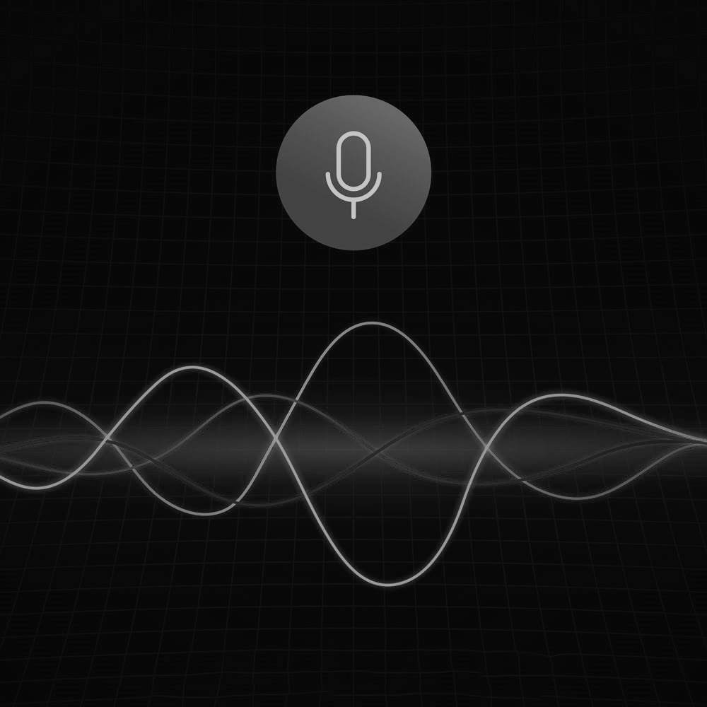

OBJECTIVE:
The main objective of this paper is to detect speech emotion correctly by using neural network techniques. The objective of Speech emotion recognition using Machine Learning is to acknowledge who is talking, speaker check, where the target is to verify a speaker’s asserted character by identifying their speech signal, and word spotting, which incorporates observing a speech for the event of determined words. Speech emotion recognition is usually beneficial for applications, which require human-computer interaction like speech synthesis, customer service, education, forensics, and medical analysis. Recognizing emotional conditions in speech signals are so much challengeable area for many several reasons. Our motto is to detect the emotions of the speaker through their speech.

Slide 8
EXISTING SYSTEM:
The existing system uses robust speech recognition. The matter is that it's having high latency and low accuracy. It's also time-consuming. The speech depends upon the surrounding environment, length of speech used, and quiet emotions each individual has.
The system is split into two stages,
The primary stage may be a training stage where the system first trains for various voices or emotions.
The second stage is to acknowledge the pattern by using the characteristics derived from the primary task.
Principal Component Analysis
Geometric methods.

Slide 9
DRAWBACKS:
Standard benchmark datasets for SER have a limited number of sentences with emotional labels, often collected from a limited number of evaluators. This limitation severely affects the generalization of the systems.
Generally, labels for emotion recognition tasks are collected with perceptual evaluations from multiple evaluators. The raters annotate samples by listening or watching the stimulus. This evaluation procedure is cognitively intense and expensive.
Low discriminatory power and high computational load.
In geometric-based methods, the geometric features like the distance between speech signals.

Slide 10
PROPOSED SYSTEM:
Speech Emotion recognition for transform features system through SVM model.
The MFCC has been used as a feature for classifying the speech data into various emotion categories employing SVM model.
This technique manages a good balance between the computational volume and performance of accuracy of the real-time processes.
The project is implemented to recognize the speech of the person by recognizing and hearing the voice of an individual. The system can identify the voice of the individual or a person whether that person is sad, happy, or angry. The relevant details about who is predicted to possess those needs, and what features the voice interface have got to meet those anticipated needs.

Slide 11
ADVANTAGES:
An advent solution bypassing the problem of an optimal feature selection has been given by the advent of the SVM model.
Robustness to illumination changes
Can be implemented in any hardware supporting the Python
Very fast in processing the audio and easy to use
Variable length audio files are understood by the system
Low complexity
High discriminatory power
It is used in a wide range of areas like customer care support, business marketing, Alexa, Siri, police inquiry, mobile phone users, call center operators and customers, car drivers, pilots, and some government apps like Nirbhaya, SOS, etc, and many other human-machine communication users.

Slide 12
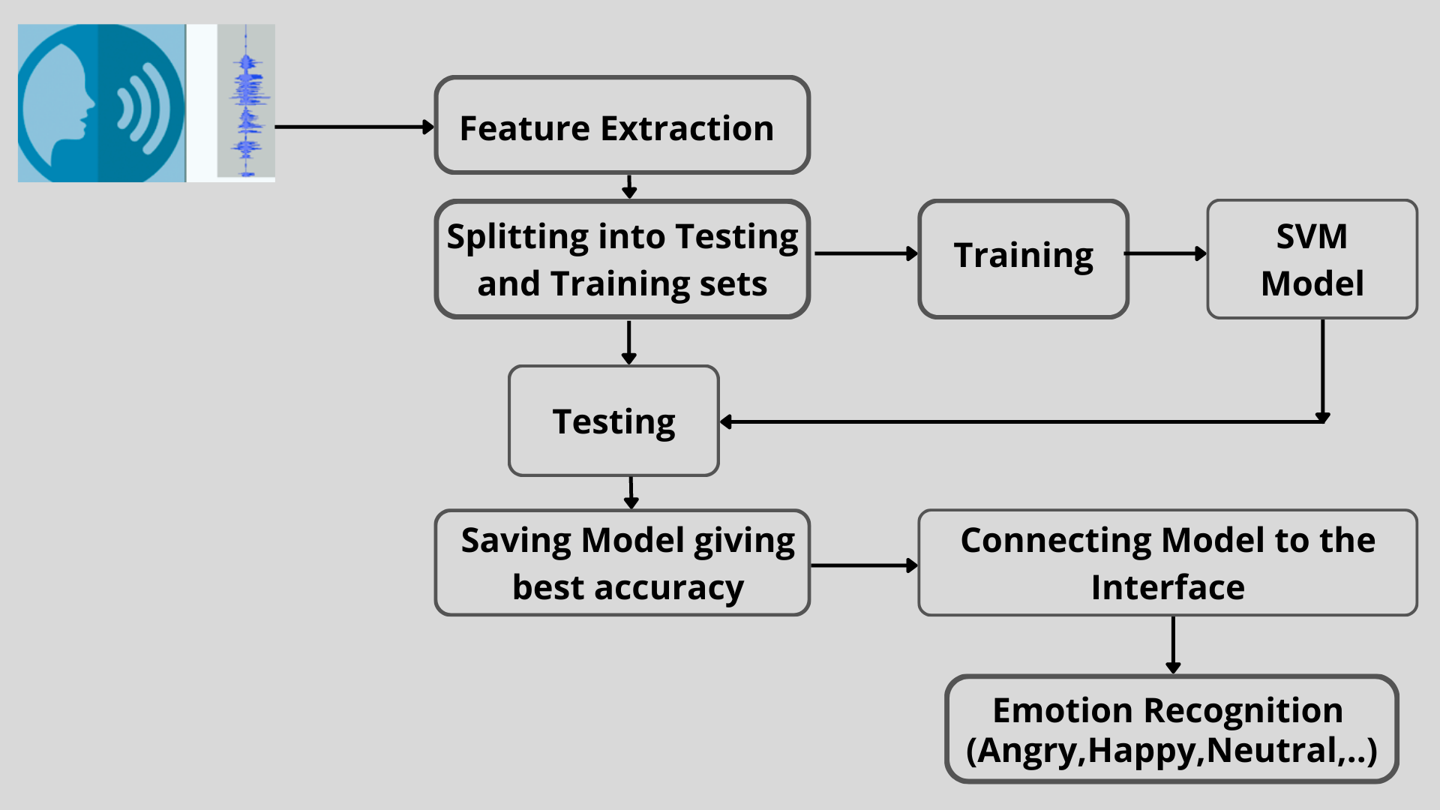
ARCHITECTURAL DIAGRAM:

Slide 13
The system architecture of the proposed model consists of the following phases:
Input Signal
Pre-processing
Feature Extraction
Training and Testing
SVM Model
Emotion Prediction
INPUT SIGNAL:
The signal goes into an electronic system. Here is the input voice or audio file.
The voice parameters affected by emotion are found to be of three main types: voice quality, utterance timing, and utterance pitch contour. These parameters are described both in general and in detail for a range of specific emotions.

Slide 14
FEATURE EXTRACTION:
The key to speech emotion recognition is the feature extraction process. The quality of the features directly influences the accuracy of classification results. Typically, the feature extraction method designs handcraft features based on acoustic features of speech.
The first issue of all speech emotional methods is selecting the best features, which are powerful enough to distinguish between different emotions. The presence of various languages, accents, sentences, speaking styles, and speakers also adds another difficulty because these characteristics directly change most of the extracted features including pitch, and energy.
SVM MODEL:
The Support Vector Machine(SVM) is used as a classifier to classify different emotional states such as anger, happiness, sadness, neutral, and fear. The Berlin emotion database and Hindi emotion database are used for extracting the features from emotional speech.

Slide 15
TRAINING AND TESTING:
Testing is a medium of expression of one's perspective or one's mental state to others. Speech Emotion Recognition (SER) can be defined as the extraction of the emotional state of the speaker from his or her speech signal.
Training task of recognizing the emotion from speech irrespective of the semantic contents. However, emotions are subjective and even for humans, it is hard to notate them in natural speech communication regardless of the meaning.
The generalization of the models is often emphasized by training on a variety of samples with diverse labels. The state-of-the-art models for standard computer vision tasks utilize thousands of labeled samples.
EMOTION PREDICTION:
Emotion prediction is a method that recognizes the human emotion derived from the subject's psychological data. SVM was used for emotion intensity recognition.

Slide 16
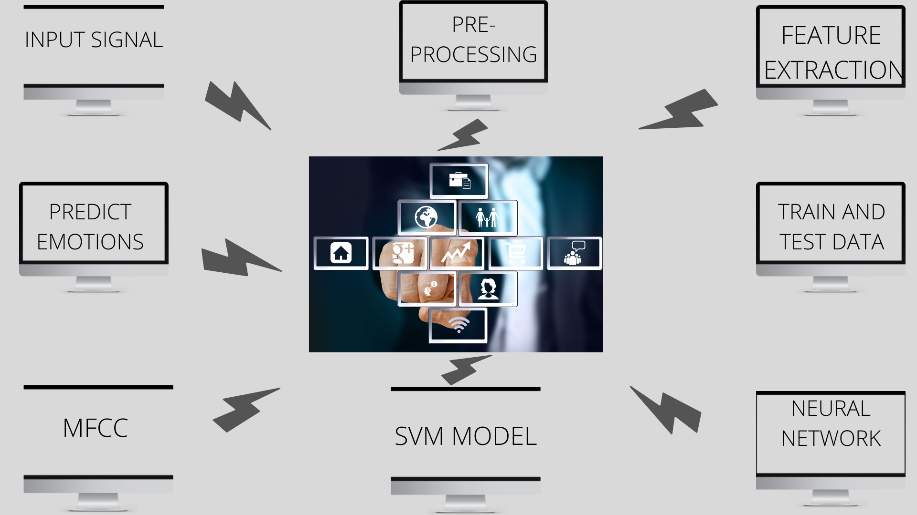
PROJECT MODULES:

Slide 17
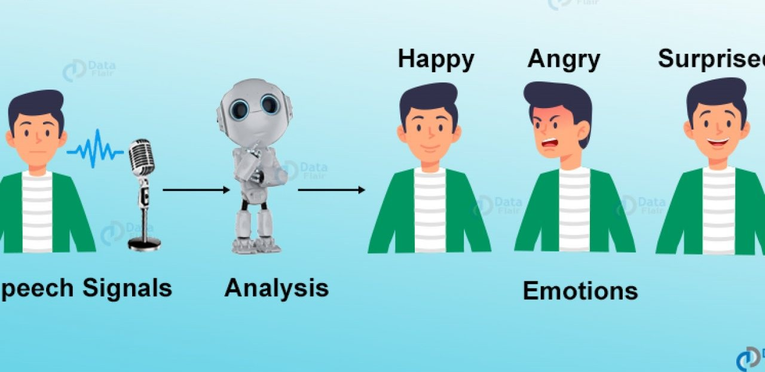
INPUT SIGNAL :
This module gives a brief detail about emotion. It also describes the system. And helps to understand the system better. We have used Python for this module.
PREPROCESSING :
The technique of preparing (cleaning and organizing) the raw data to make it suitable for building and training Machine Learning models.
5 major steps of data preprocessing :
Preprocessing in Data Mining: Data preprocessing is a data mining technique that is used to transform the raw data into a useful and efficient format Steps
Involved in Data Preprocessing
Data Cleaning
Data Transformation
Data Reduction

Slide 18

TRAINING AND TESTING DATASETS:
Separating data into training and testing sets is an important part of evaluating data mining models. Typically, when you separate a data set into a training set and testing set, most of the data is used for training, and a smaller portion of the data is used for testing.
By default, the Test set is split into 30 % of actual data and the training set is split into 70% of the actual data.
For training purposes, we use the predefined un-trained dataset CSV file as the main input for training the machine.
DATA SET SPLITTING SYNTAX:
train_test_split(*arrays, test_size=None, train_size=None, random_state=None,
shuffle=True, stratify=None)

Slide 19
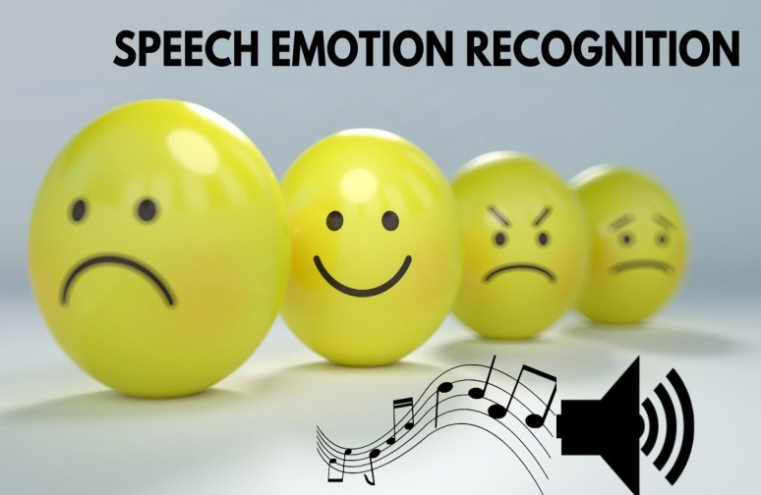
MEL-FREQUENCY CEPSTRUM COEFFICIENT (MFCC):
MFCC is the most used representation of the spectral property of voice signals. These are the best for speech recognition as it takes human perception sensitivity with respect to frequencies into consideration.
PREDICT EMOTIONS:
Formally, given some text, the task of emotion recognition is to predict explicit as well as implicit emotions. Emotions are represented either as a categorical label (e.g., sad, happy, surprise.
A comparative study and implementation of algorithms for measuring facial emotions and their intensities based on the different AUs (Action Units) are presented.
For detecting the emotion run the train.py program to train the data.

Slide 20
HARDWARE REQUIREMENTS:
System
PROCESSOR: Core i3
RAM: 8GB
HARD DISK: 500 GB
SOFTWARE REQUIRED:
OPERATING SYSTEM: Windows 10 and above versions
TECHNOLOGY USED: MATLAB 7.5 and above versions
PROGRAMMING LANGUAGE:
Python

Slide 21
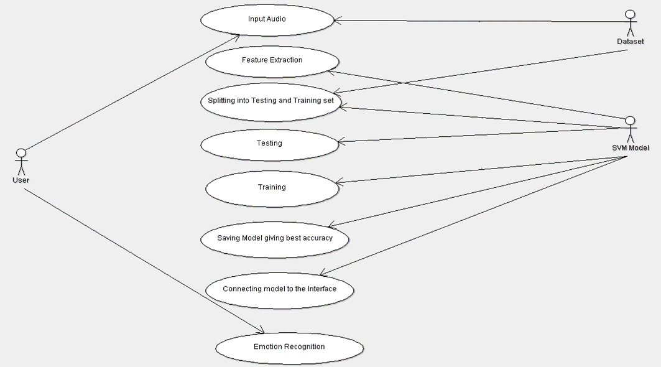
USE – CASE DIAGRAM:

Slide 22
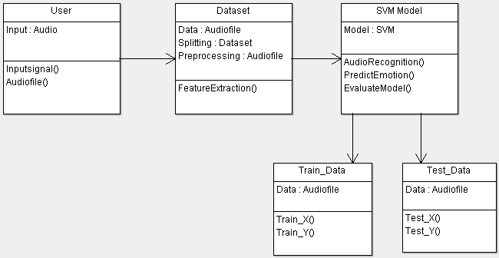
CLASS DIAGRAM:

Slide 23
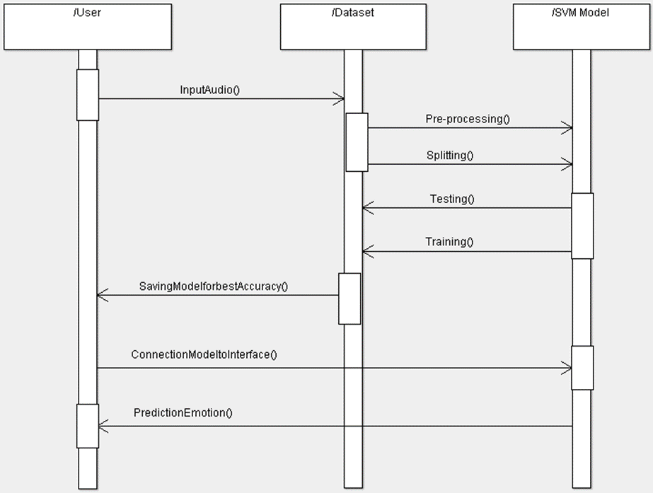
SEQUENCE DIAGRAM:

Slide 24
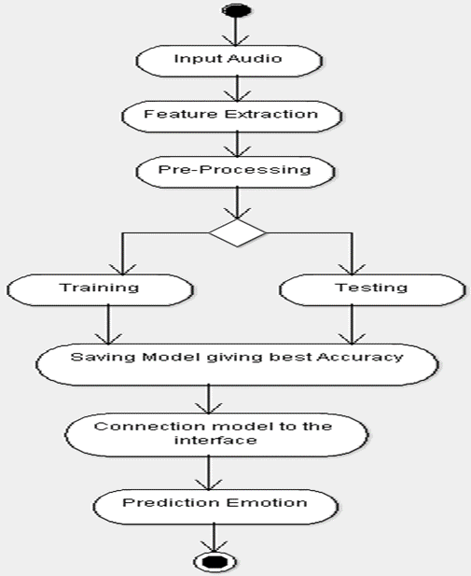
ACTIVITY DIAGRAM:

Slide 25
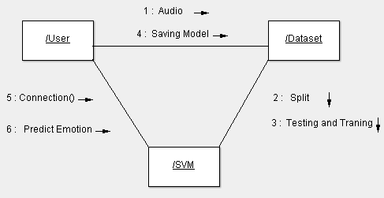
COLLABORATION DIAGRAM:

Slide 26
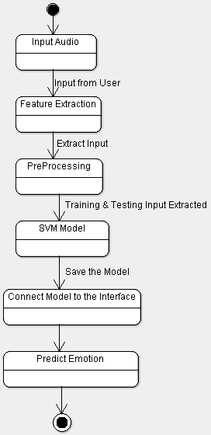
STATE CHART DIAGRAM:

Slide 27
IMPLEMENTATION:
ALGORITHM:
The Support Vector Machine (SVM) is used as a classifier to classify different emotional states such as anger, happiness, sadness, neutral, and fear, from emotional database. The SVM is used for the classification of emotions.
Support Vector Machine(SVM) is a supervised machine learning algorithm used for both classification and regression. Though we say regression problems as well it’s best suited for classification. The objective of the SVM algorithm is to find a hyperplane in an N-dimensional space that distinctly classifies the data points.
The importance of emotions in human-human interaction provides the basis for researchers in the engineering and computer science communities to develop automatic ways for computers to recognize emotions.
The input to the system is a dataset file from the Emotion Database that contains emotional speech utterances from different emotional classes.
After that features extraction process is carried out. In the feature extraction process the features are extracted (MFCC ).
After that the extracted features and their corresponding class labels are given as input to the SVM classifier.
The output of a classifier is a label of a particular emotion class. The classes angry, sad, happy, neutral, aggressive, fear, and painful, etc., Each label represents a corresponding emotion class.

Slide 28
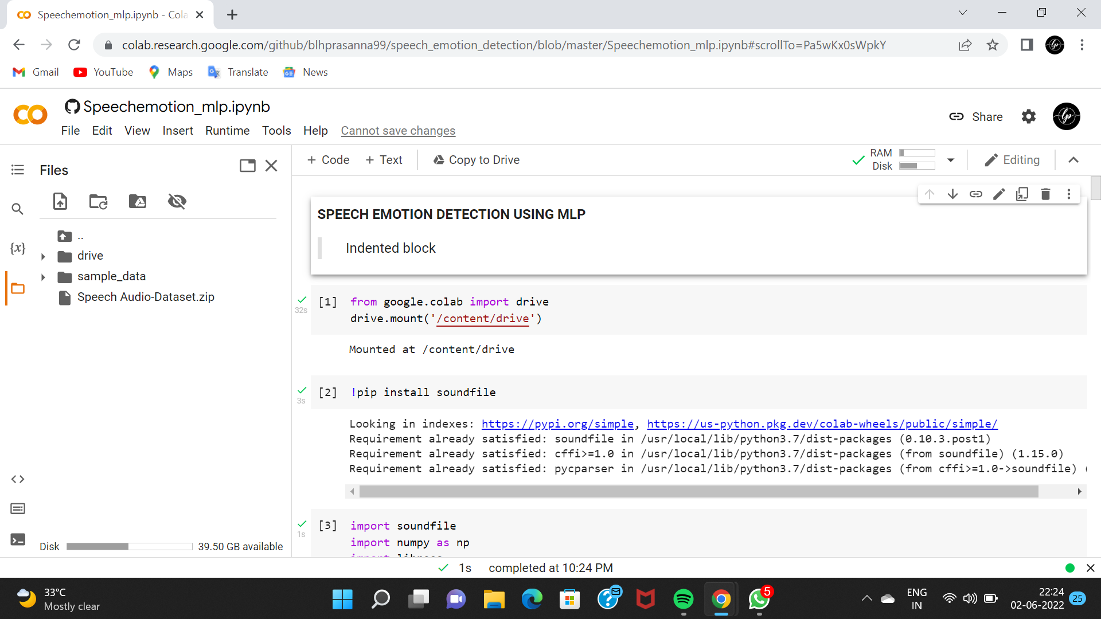
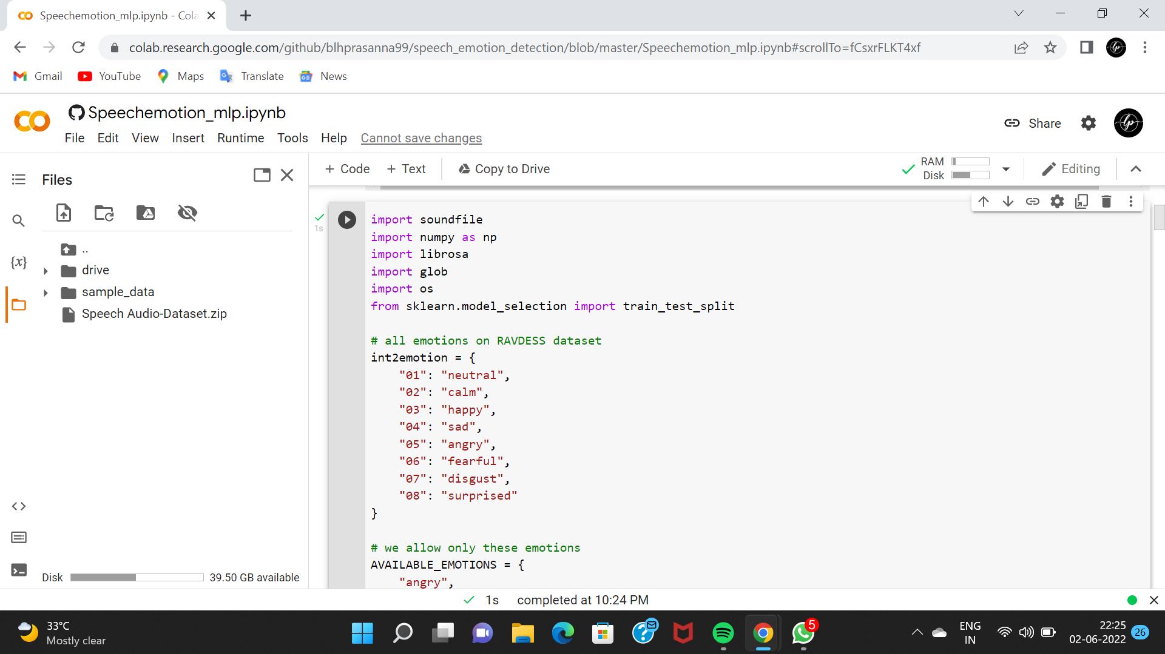
SOURCE CODE:

Slide 29
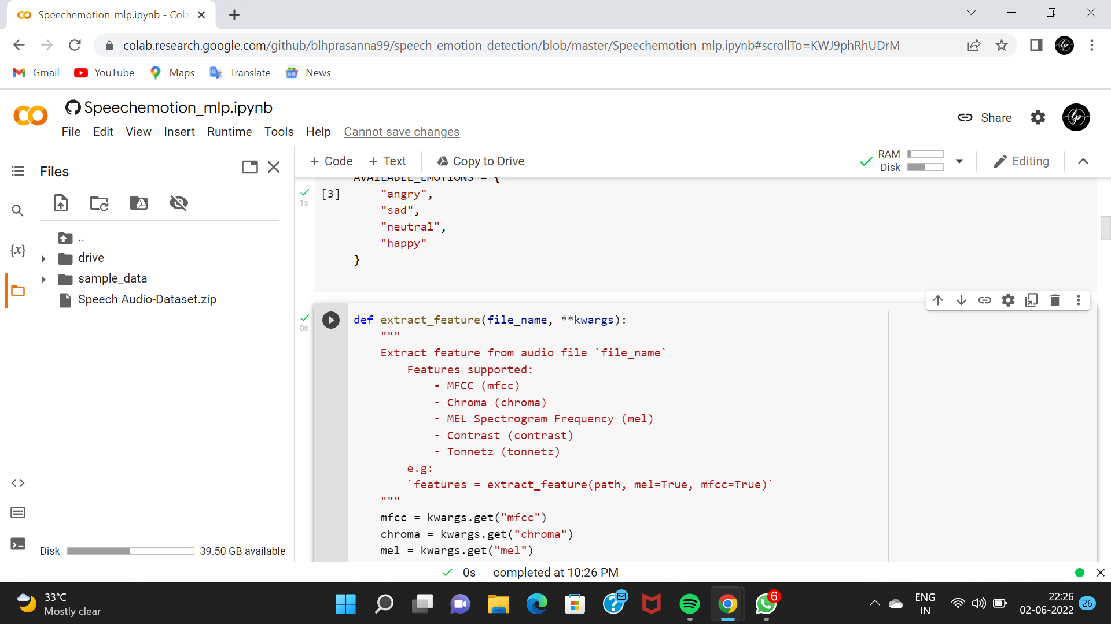
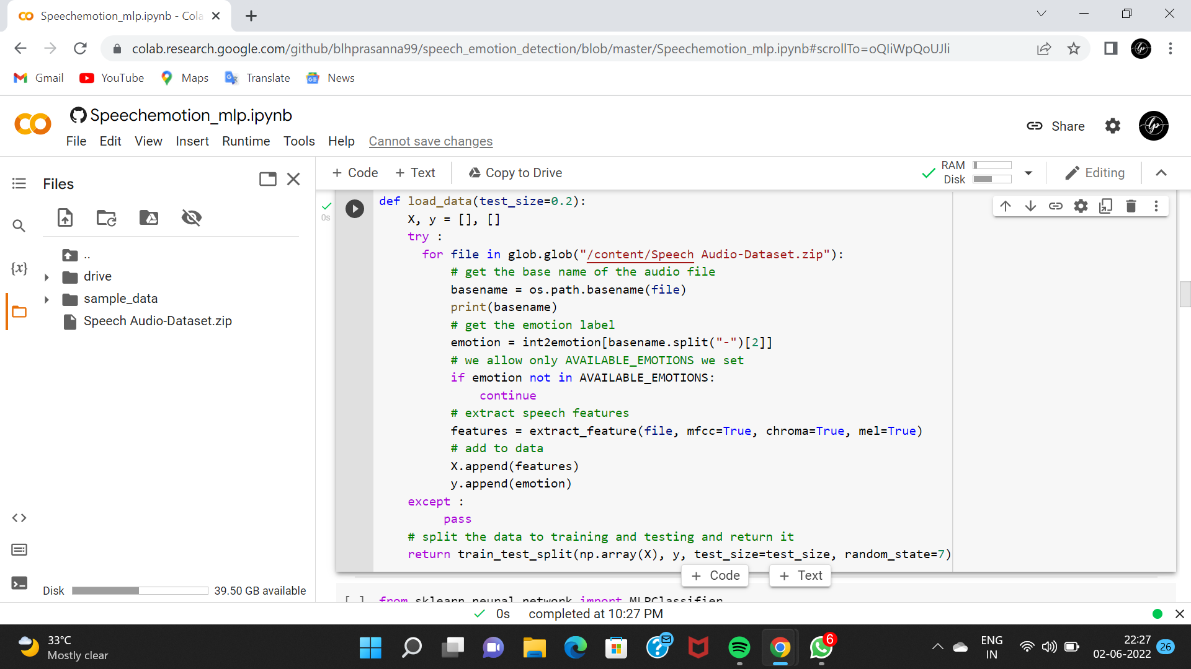
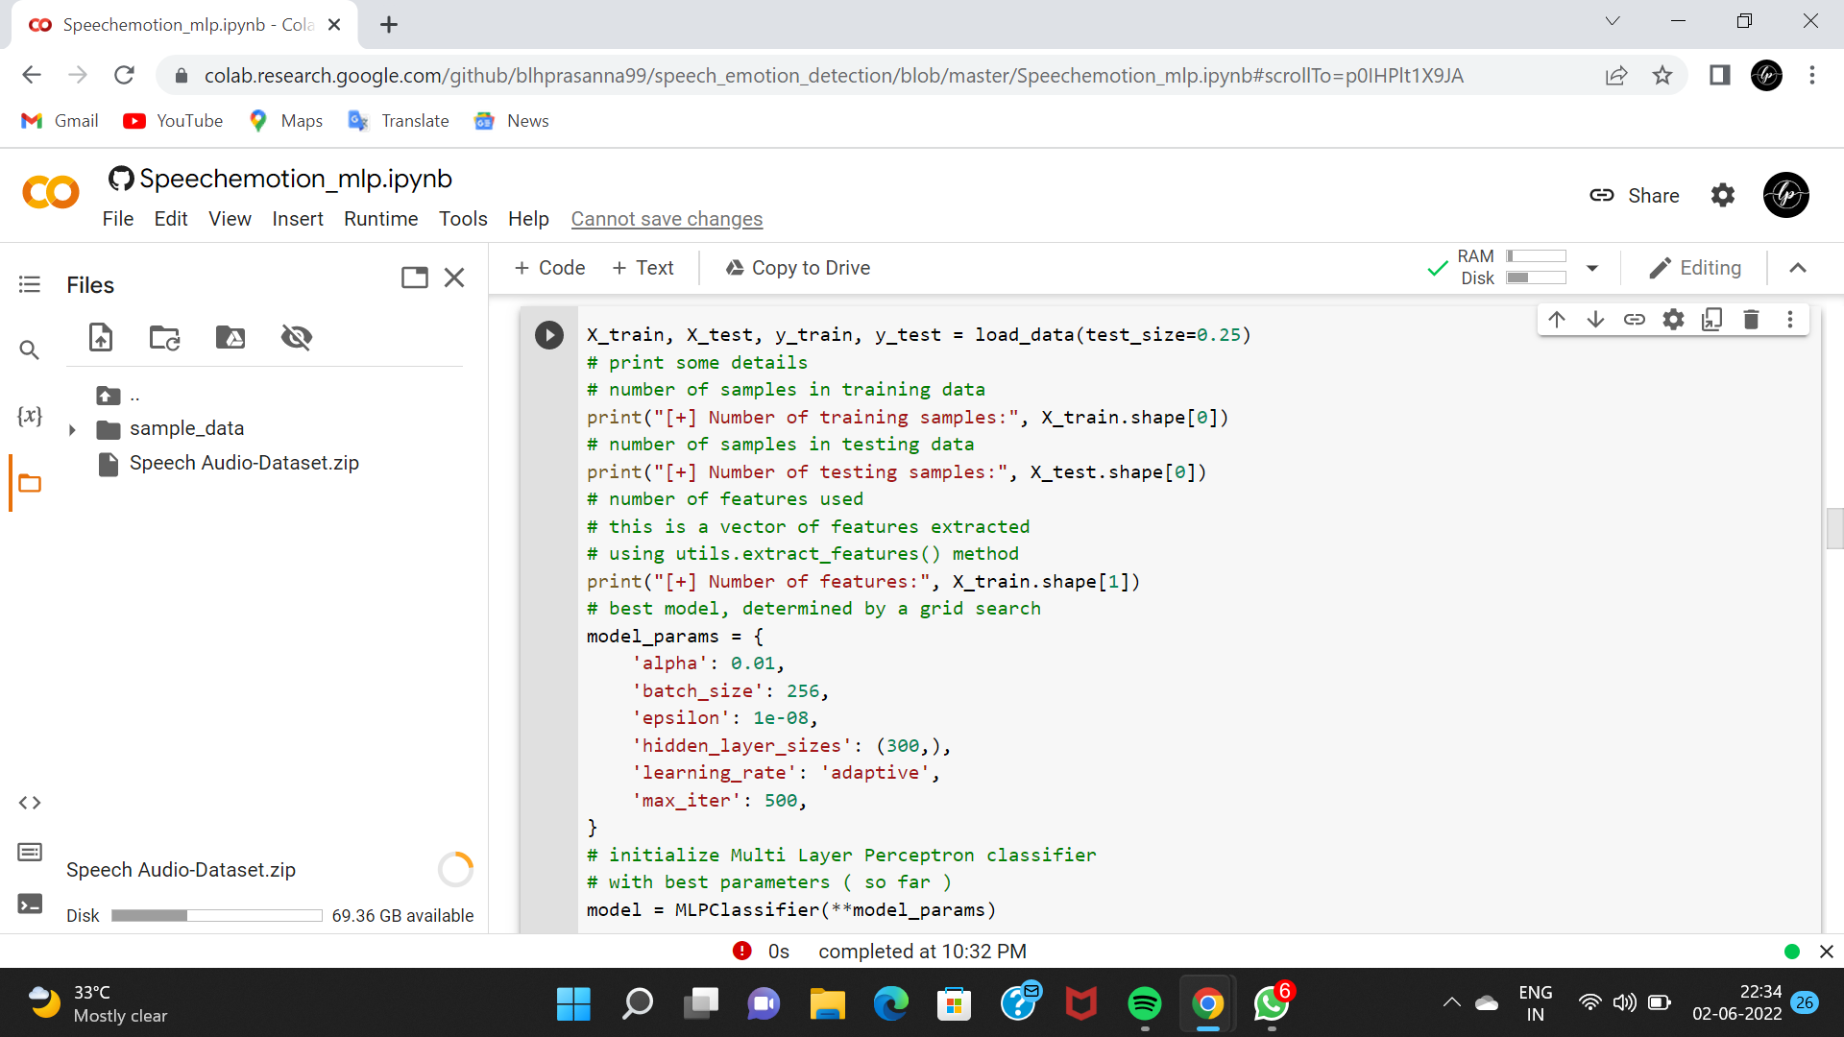

Slide 30
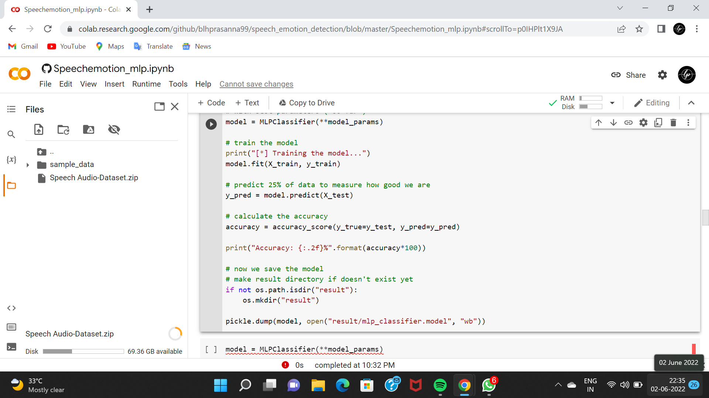

Slide 31
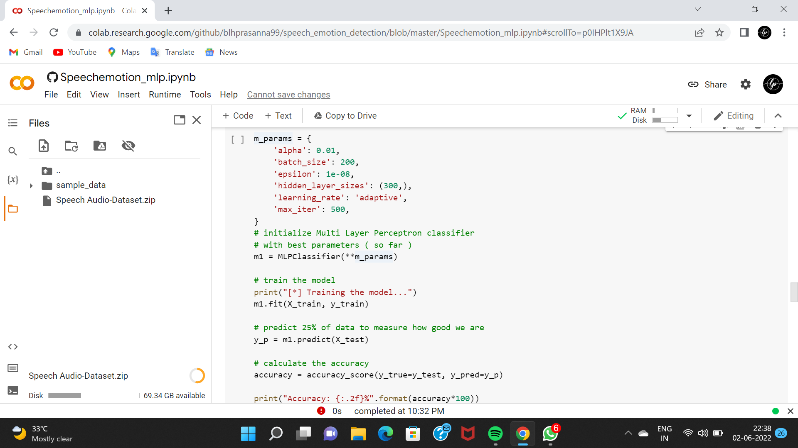
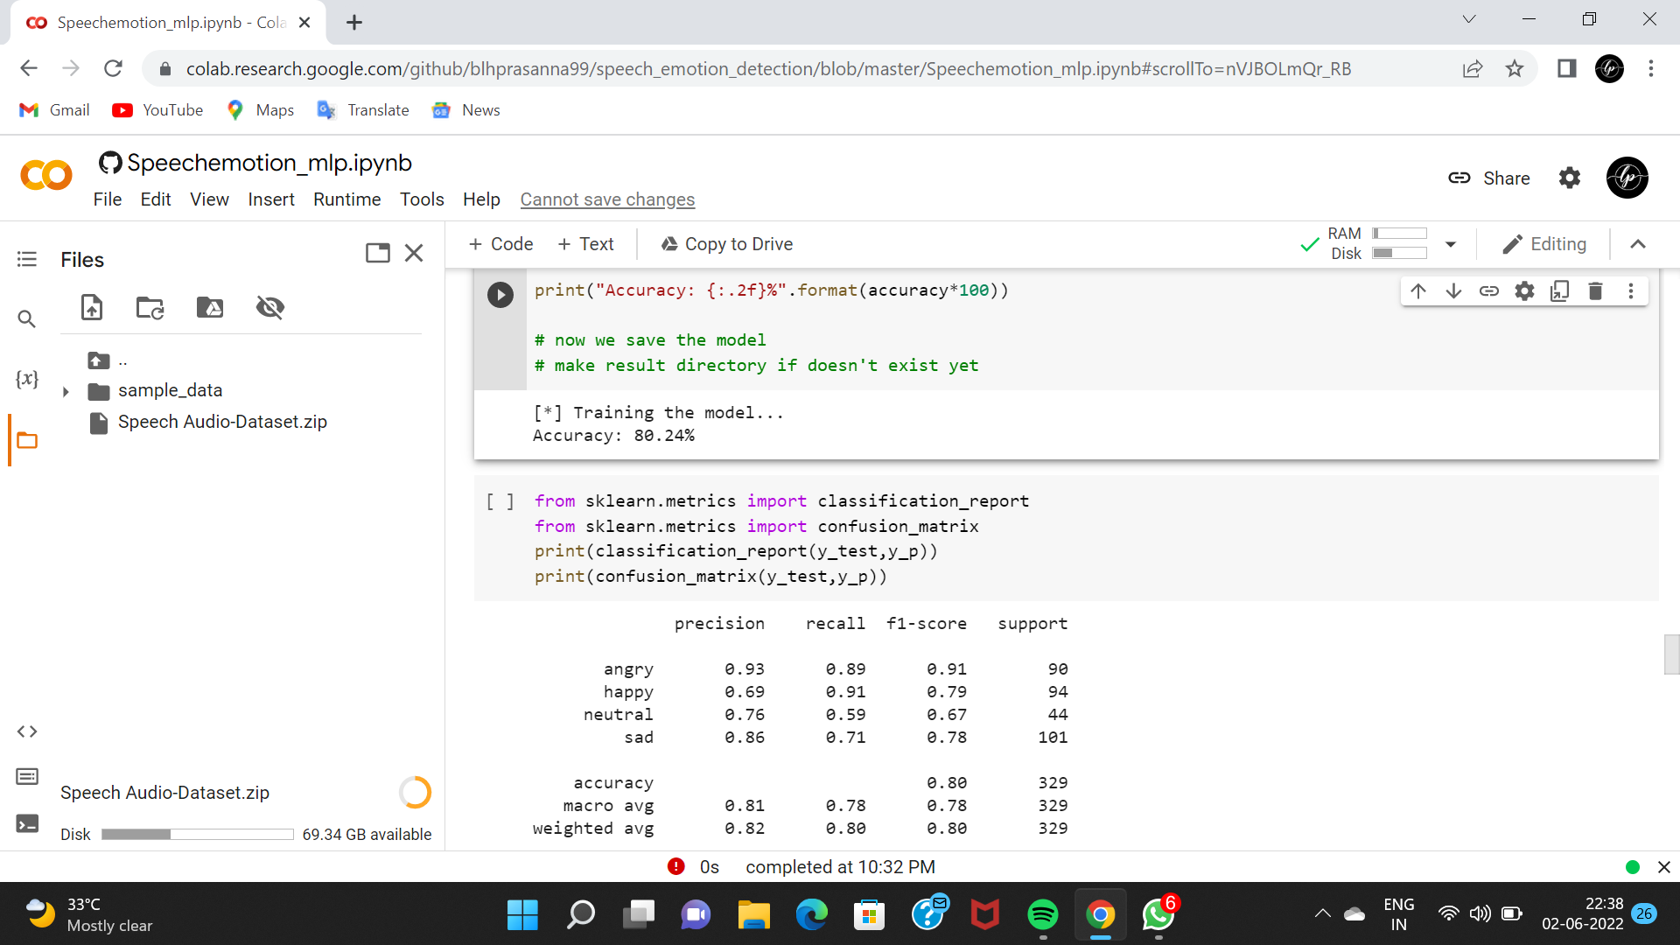

Slide 32
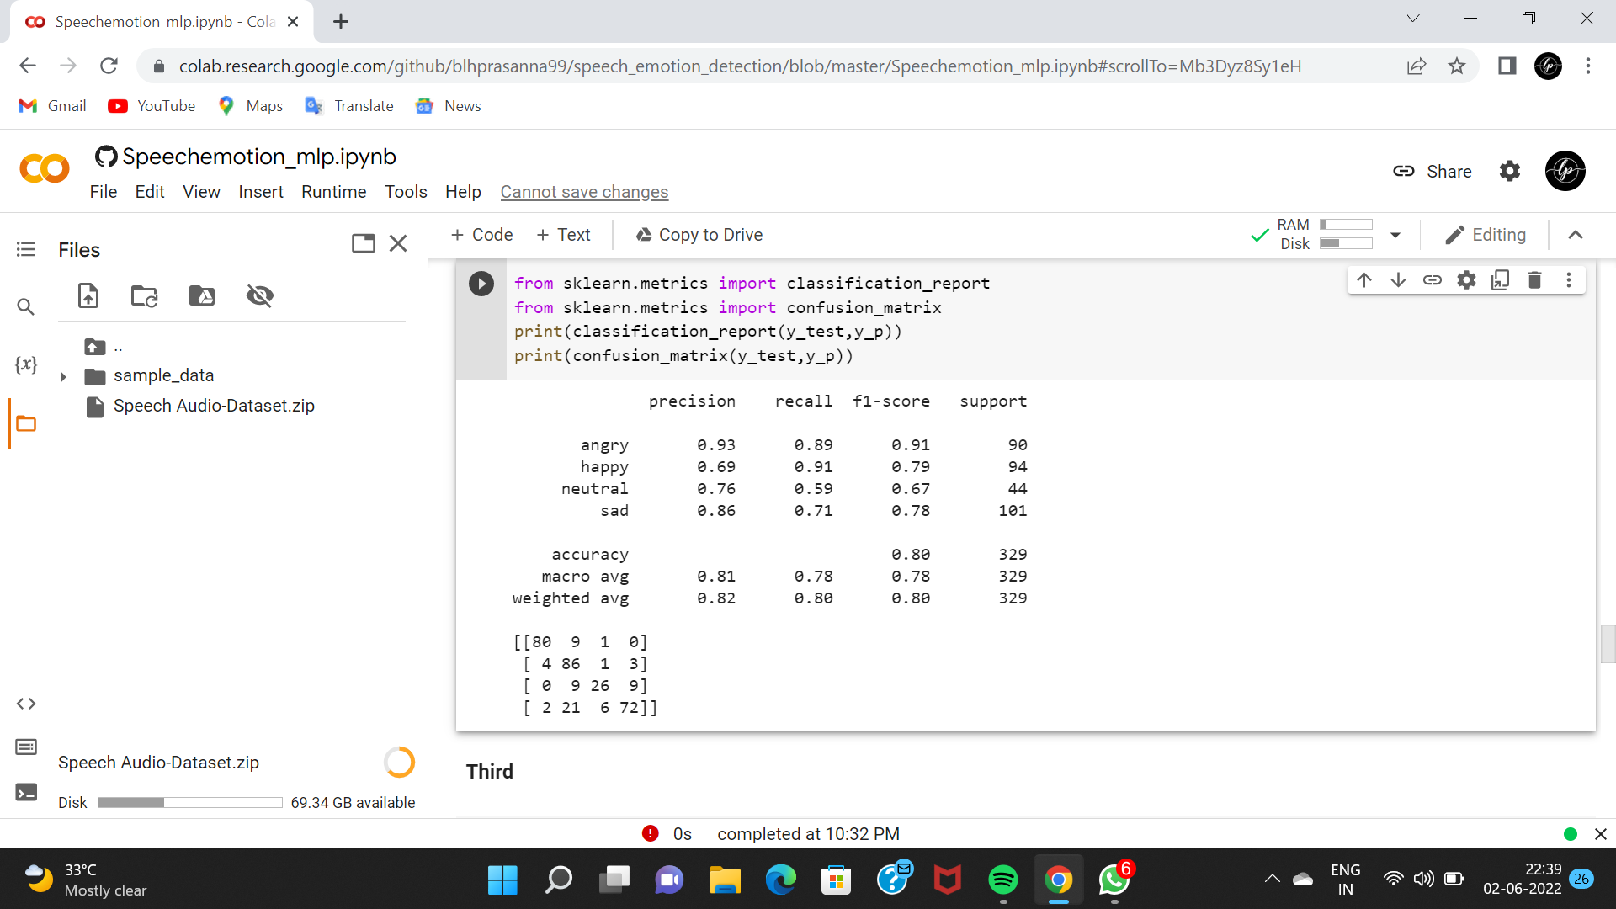
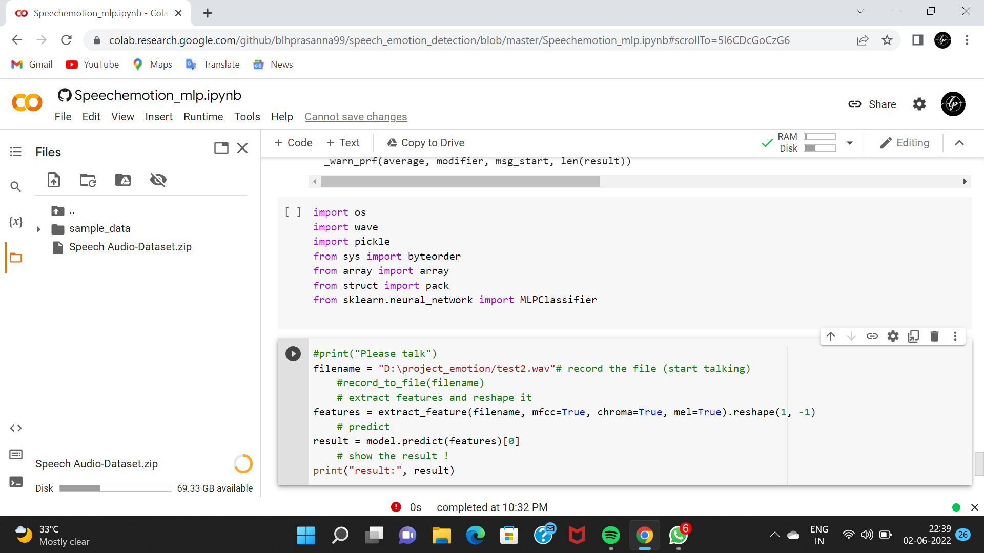

Slide 33
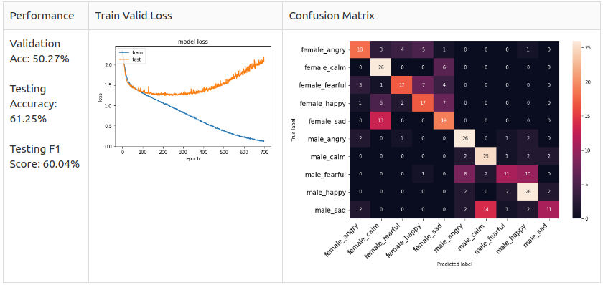
OUTPUT:
SCREENSHOT 1:
EMOTION PREDICTION FOR THE FEMALE VERSION

Slide 34
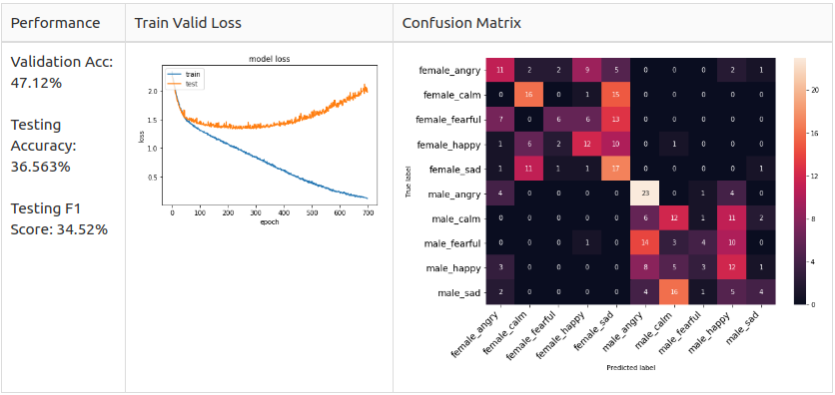
SCREENSHOT 2:
EMOTION PREDICTION FOR THE MALE VERSION

Slide 35
CONCLUSION:
This paper is predicated on speech emotion recognition using a support vector machine model. During this section, we summarize the datasets, methods, and approaches in SER. Here speech is the major source of human understanding so it is often utilized in major events for basic communication. This technology is employed in various fields of human-machine interaction. Here it is often utilized in online communication where machine understands human emotion and may ask human what emotion were human is. This proposed work of Emotion Recognition for input speech is based on feature extraction and classification techniques. Here we are extracting the MFCC feature from a human’s speech signal for different emotional states. This system aims to solve the manual method problems of the existing system. This system is user-friendly and creates a bridge between machines and humans.
“We’re fascinated with machines that act in a human-like manner by predicting emotions because they’re a reflection of ourselves”

Slide 36
FUTURE ENHANCEMENT:
In the future we increased the performance of this process and able to get more accuracy.
The main implementation of our project is to recognize the emotions even on live ongoing calls.

Slide 37
REFERENCES:
[1] Dias Issa, M. Fatih Demirci, Adnan Yazici,Speech emotion recognition with deep convolutional neural networks,Biomedical Signal Processing and Control,Volume 59,2020,101894,ISSN 1746-8094.
[2] Jianhua Zhang, Zhong Yin, Peng Chen, Stefano Nichele, Emotion recognition using multi-modal data and machine learning techniques: A tutorial and review, Information Fusion, Volume 59,2020,Pages 103-126, ISSN 1566-2535.
[3] T.Sai Samhith, G.Nishika, M.Prayuktha, M.Bharat Chandra, Dr.Sunil Bhutada, G.Prasadu, Speech Emotion Recognition using Machine Learning Algorithms, Volume 9, Issue 6 June 2021, © 2021 IJCRT, ISSN: 2320-2882
[4] Leila Kerkeni, Youssef Serrestou, Mohamed Mbarki, Kosai Raoof, Mohamed Ali Mahjoub and Catherine Cleder, Automatic Speech Emotion Recognition Using Machine Learning, March 2019.

